Slide 1

Investigating Wagner group ties to the government of Burkina Faso
Alex holida
May 11th, 2023

Slide 2

Agenda
BACKGROUND
OBJECTIVE
METHODS/CODE
RESULTS
DISCUSSION
QUESTIONS

Slide 3
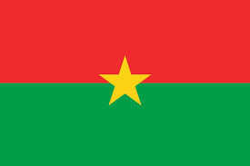
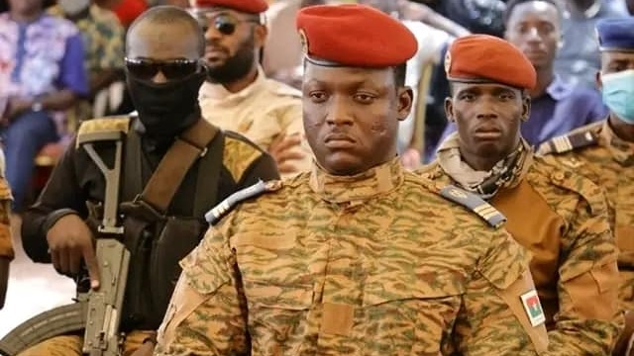
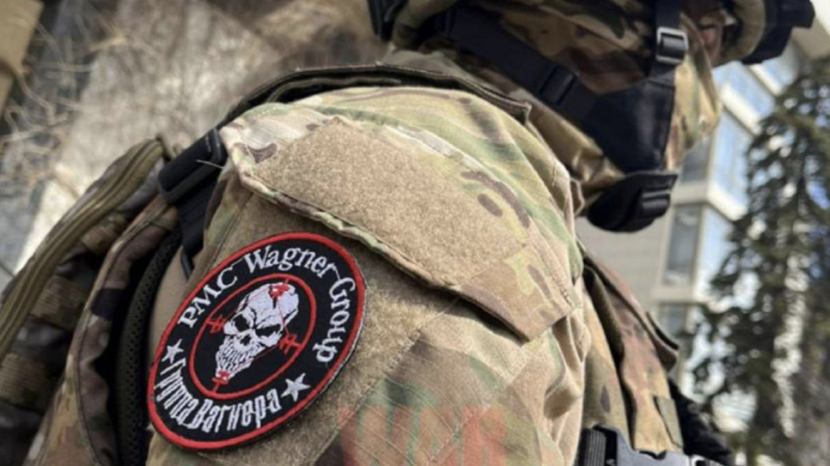
Background
Burkina Faso
Extremely underdeveloped
Increased terrorism activity
Shares a border with Mali
Large mining industry
Capt Ibrahim Traoré
Took power after a second coup Dec 2022
Promises democratic leadership with elections
Accused by Ghanian gov’t of working with Wagner Group
Wagner Group
Supports Russian influence on African nations
Provides protection in exchange for mining rights
Ties to white supremacy and potential crimes against humanity

Slide 4
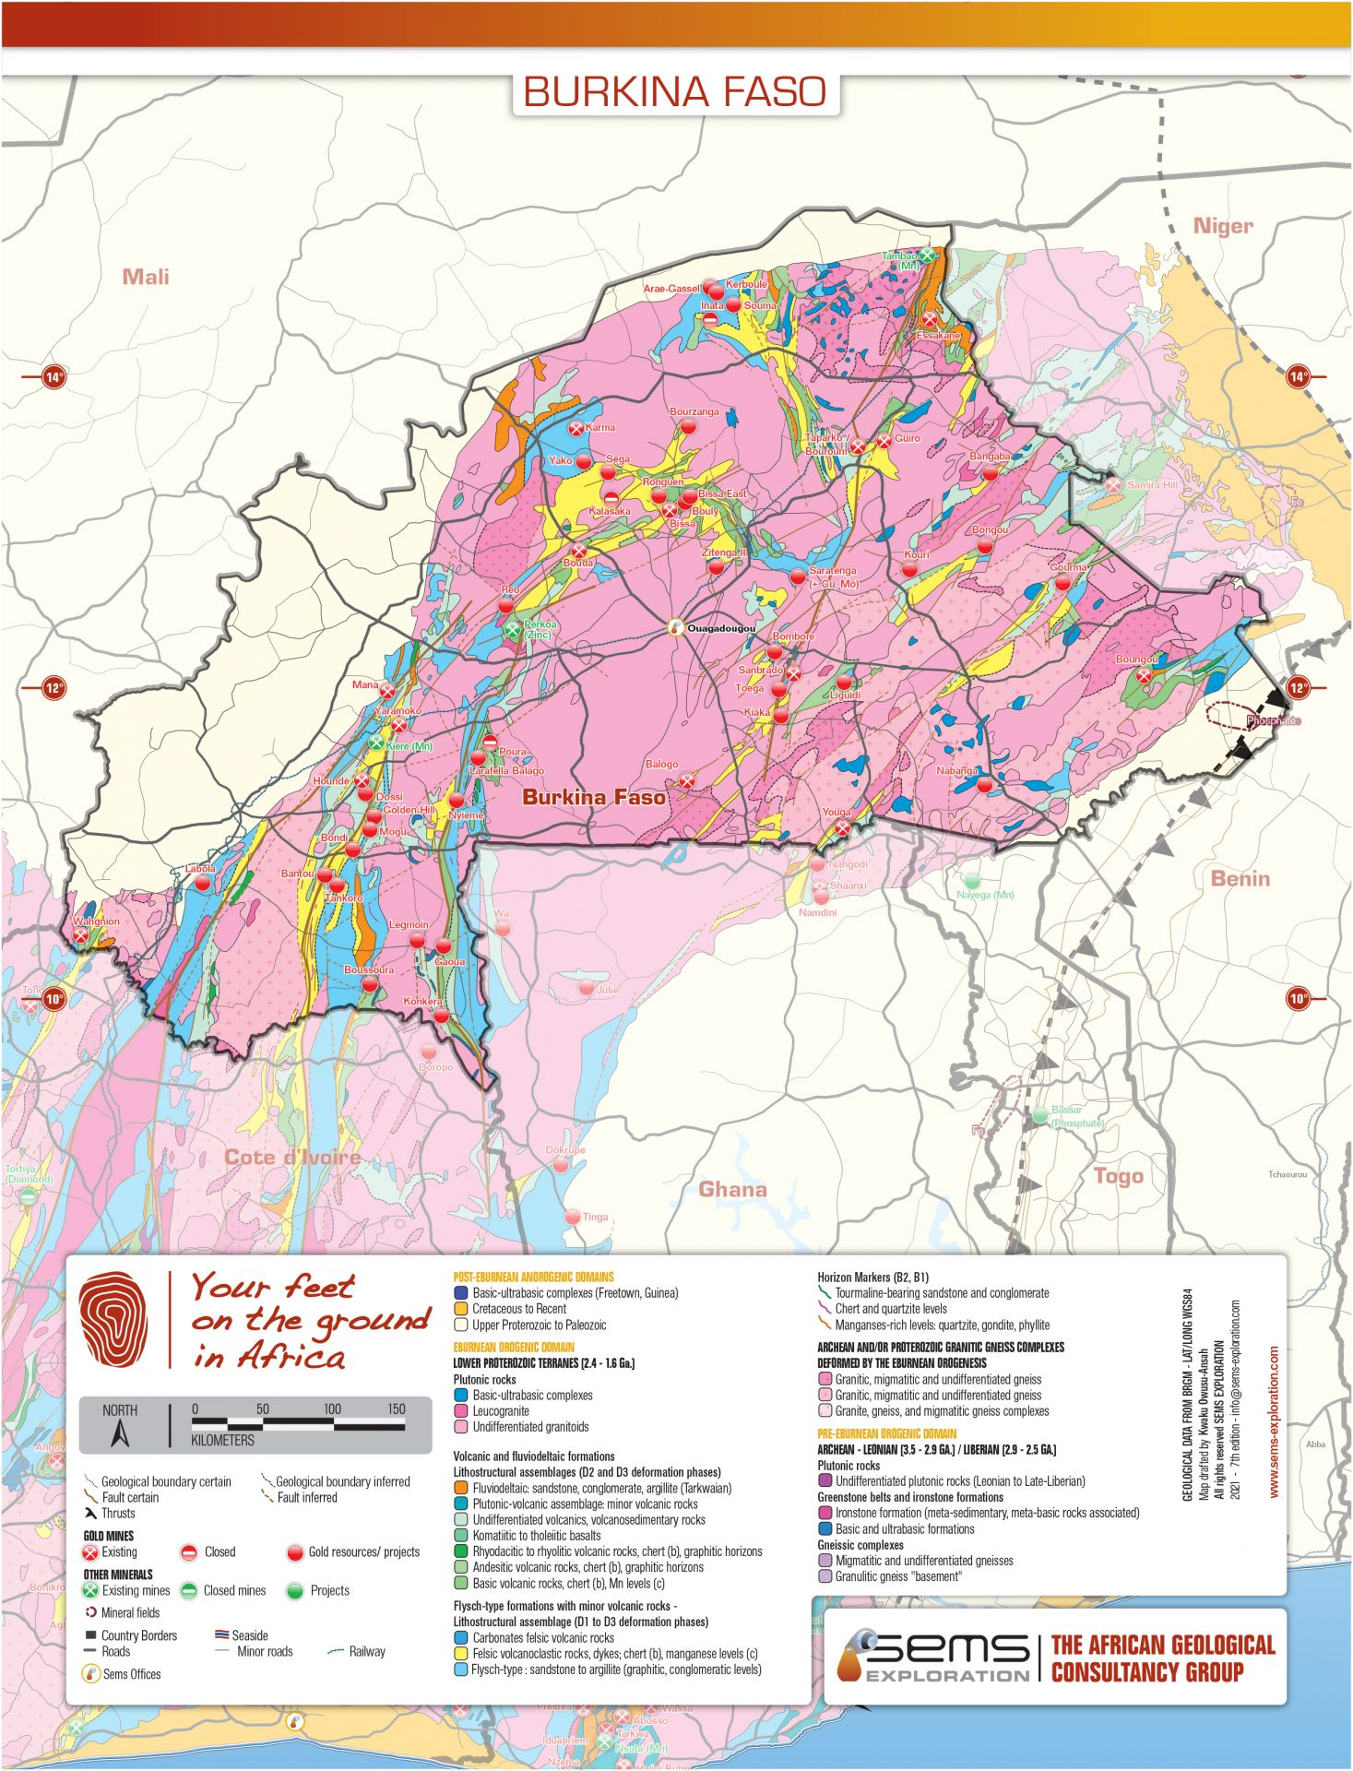
OBJECTIVE
IS THE RUMOR THAT TRAORE IS WORKING WITH THE WAGNER GROUP TRUE?
HAS TRAORE MET WITH MEMBERS OF THE WAGNER GROUP?
IS THERE PHOTOGRAPHIC EVIDENCE THAT TIES THE TWO TOGETHER?

Slide 5

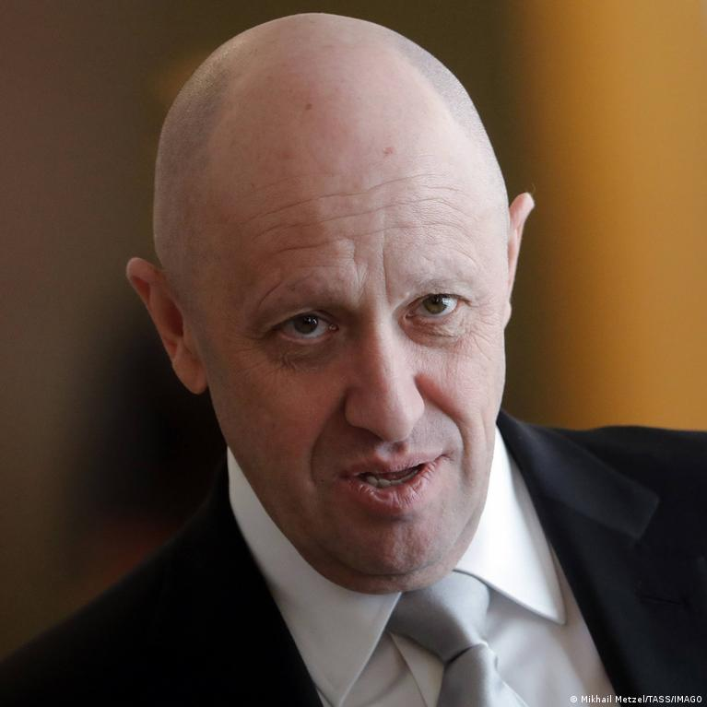
Methods/code
Used an Azure API resource to pull images of Captain Ibrahim Traoré
Filtered images with the parameter of being posted between December 2022 and today
Used face_recognition library to encode a known image of Yevgeny Prigozhin of identify him in images from the Bing Image Search results
List matches and the affiliated URL to inspect

Slide 6
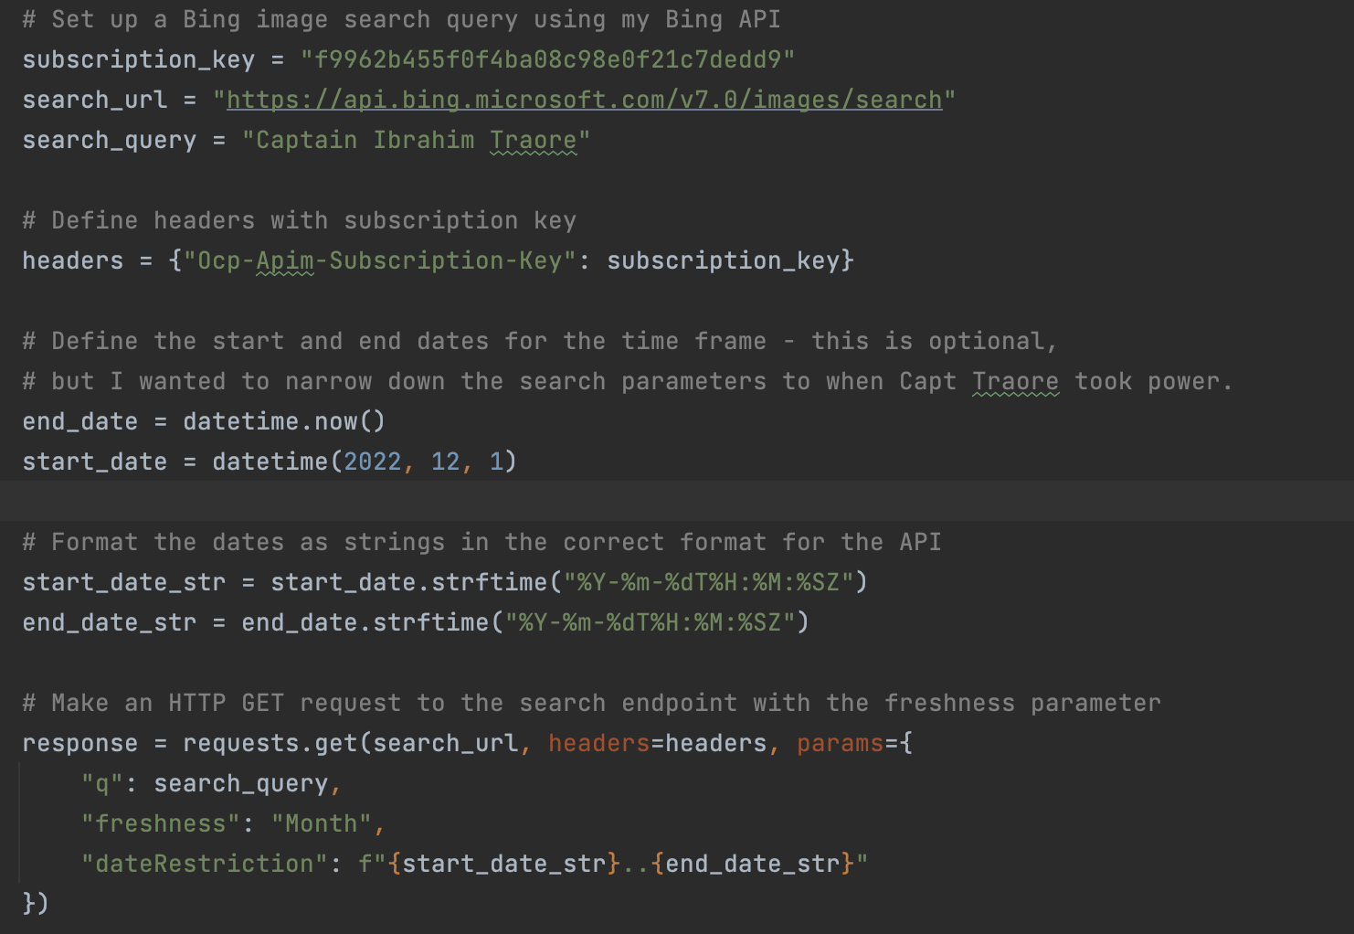

Slide 7
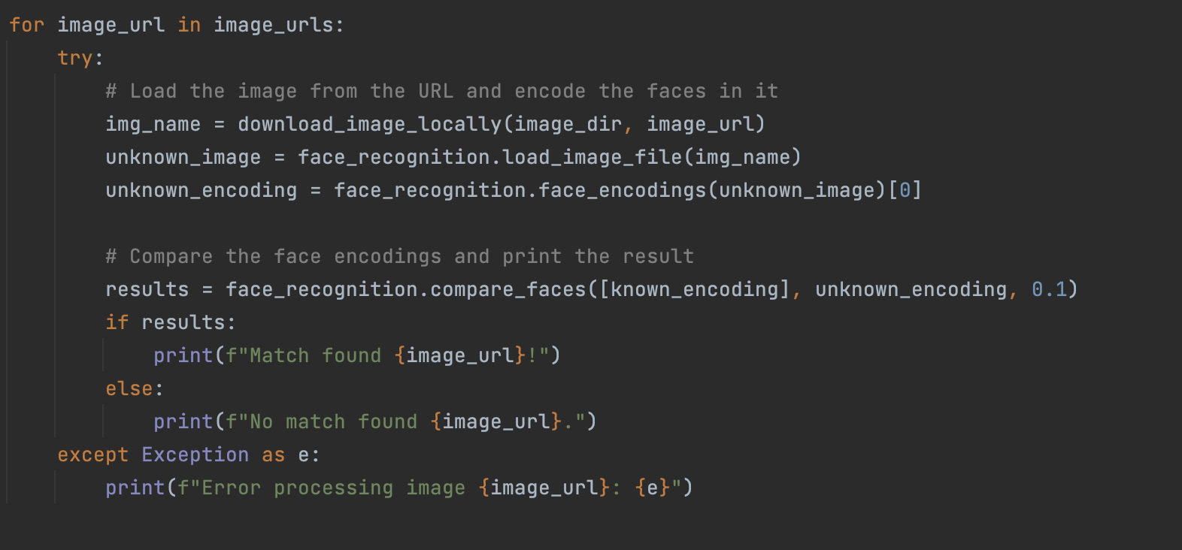

Slide 8
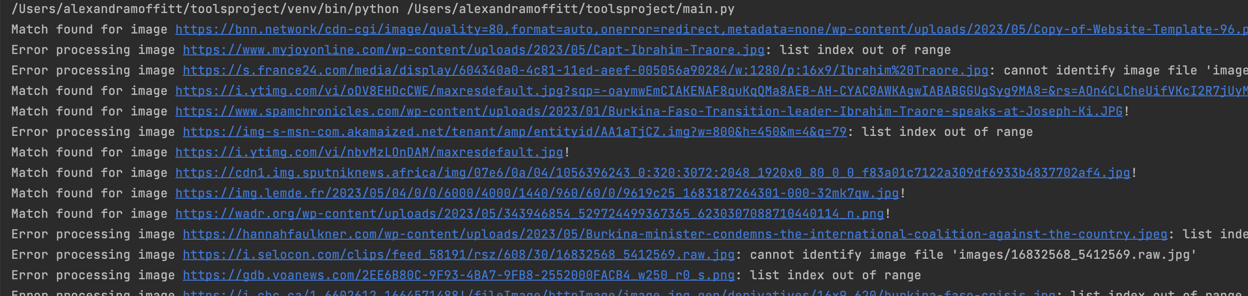
RESULTS
Code “ran successfully” with no errors….
….but the facial recognition aspect did not yield the correct results
Received 10 ”matches” and 12 “error processing images”

Slide 9
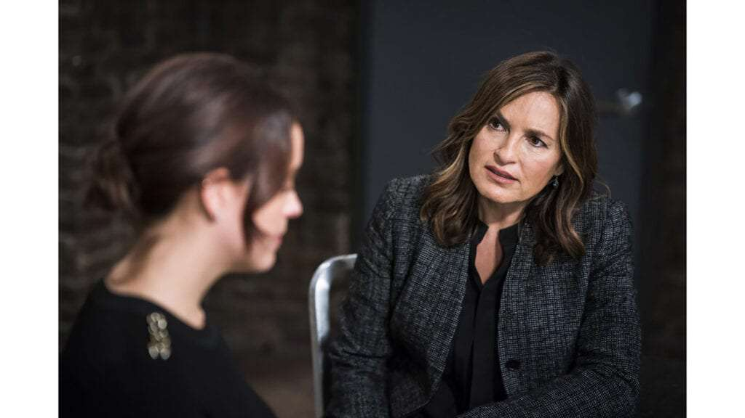
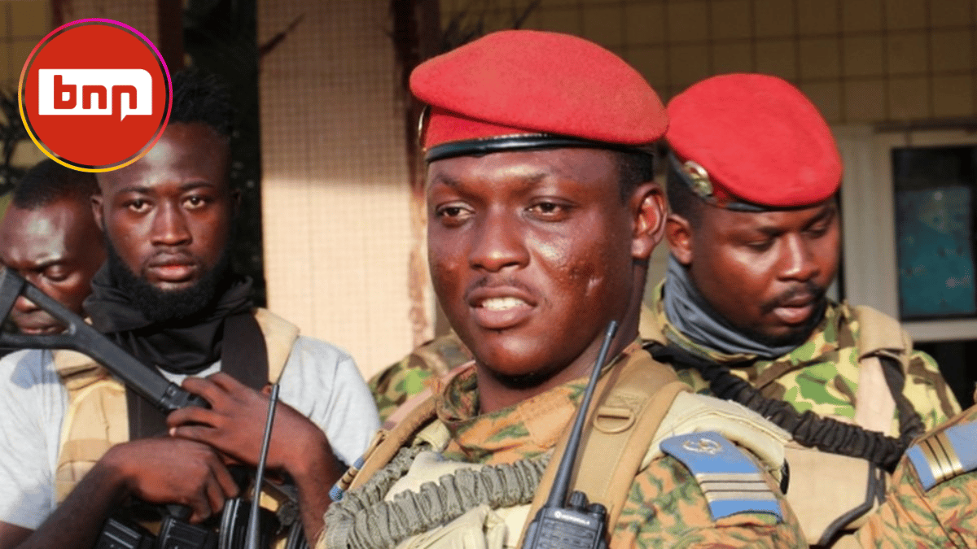
Results

Slide 10

DISCUSSION
CAVEATS
NEXT STEPS
Publicly available images
AI is biased
Most basic use of facial recognition tools
Likely that these two have never met
Work with tolerance parameters
Identify other “targets” to run image searches on
Work with better sources (surveillance images and video)

Slide 11
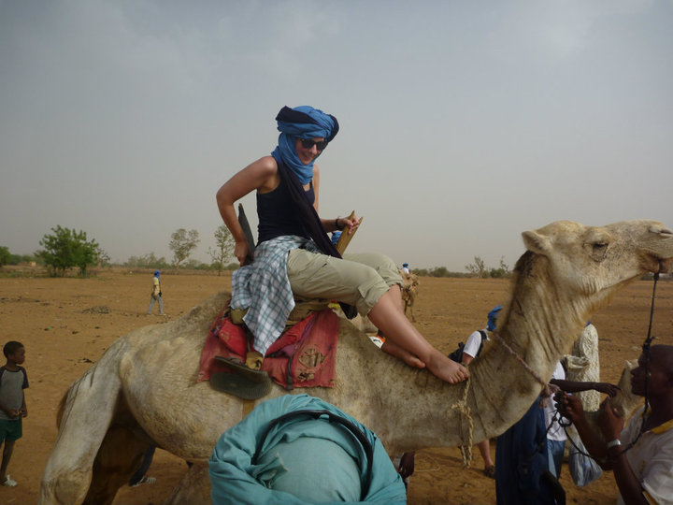
Questions?

